Slide 1
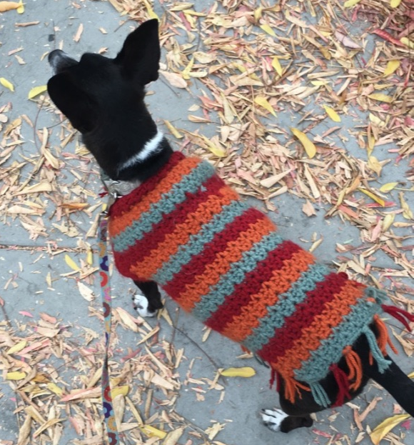
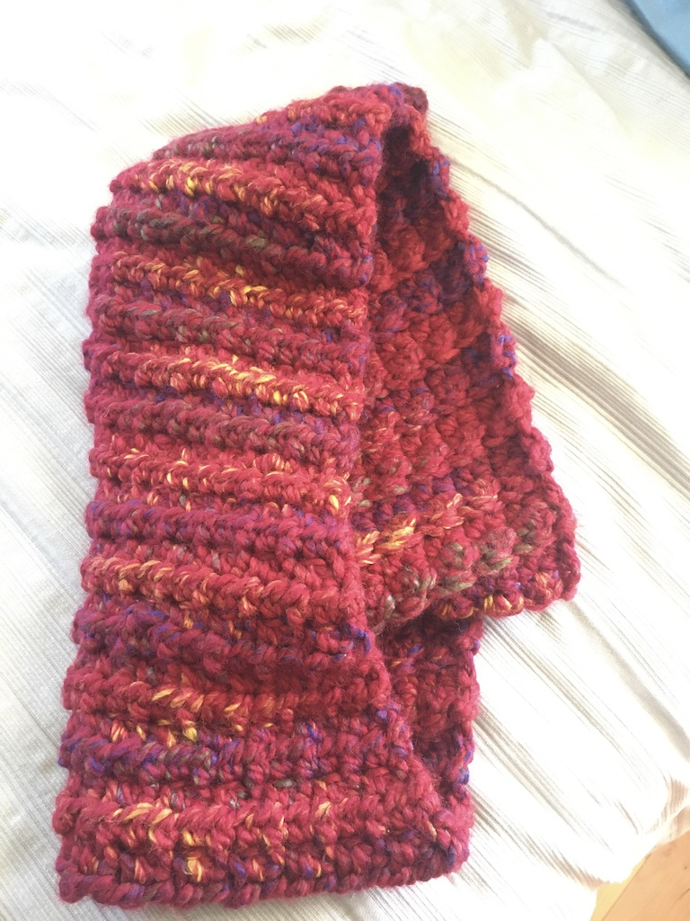
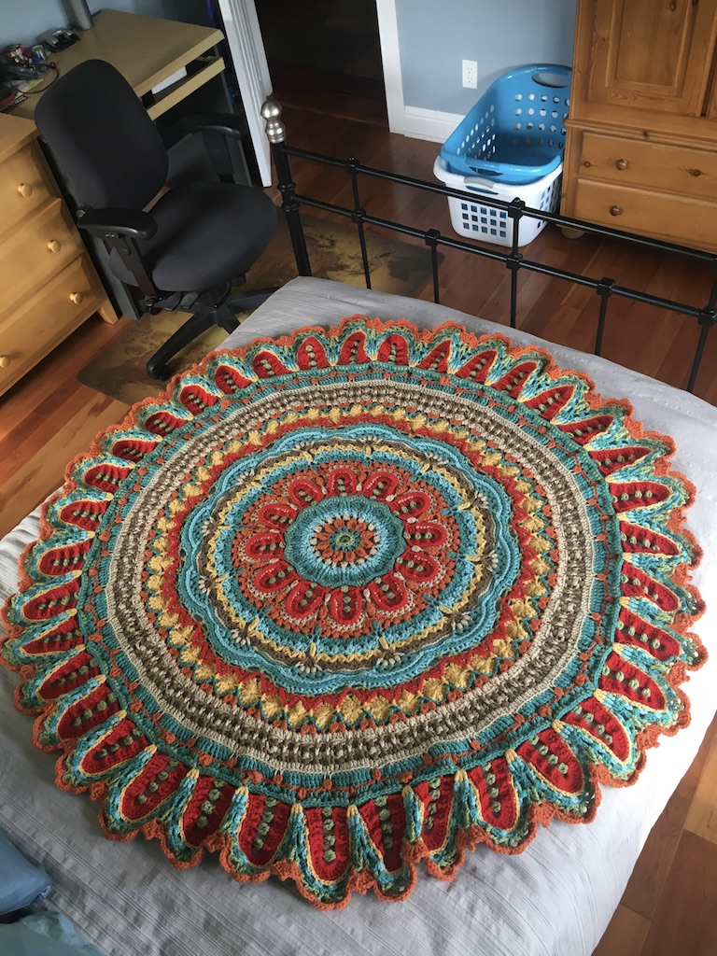
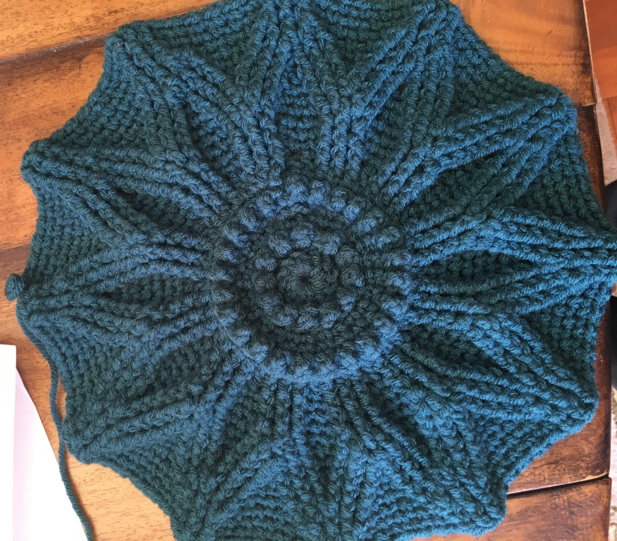
Crochet Simulator

Slide 2
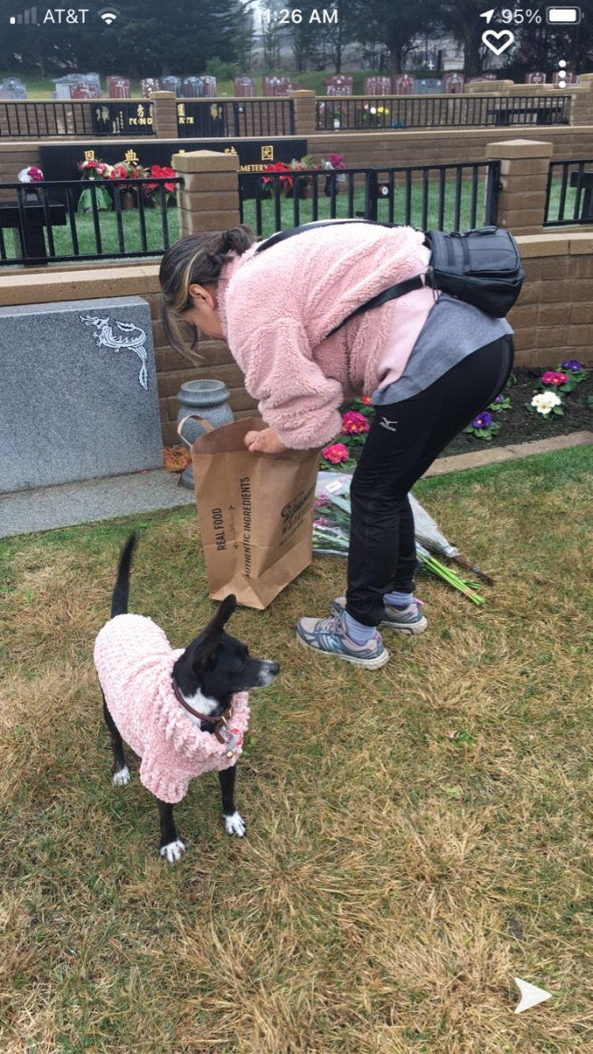
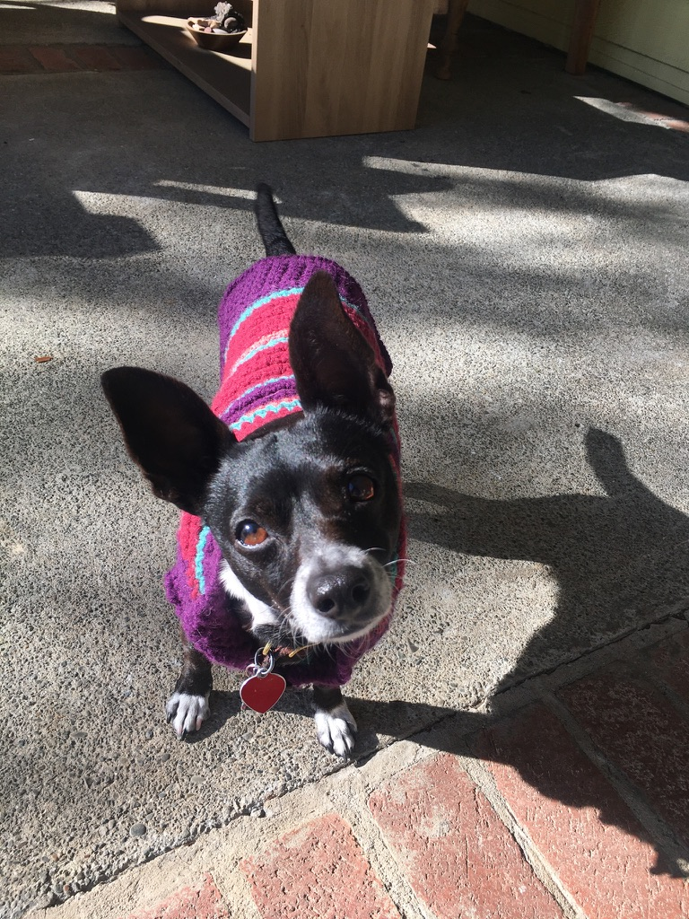
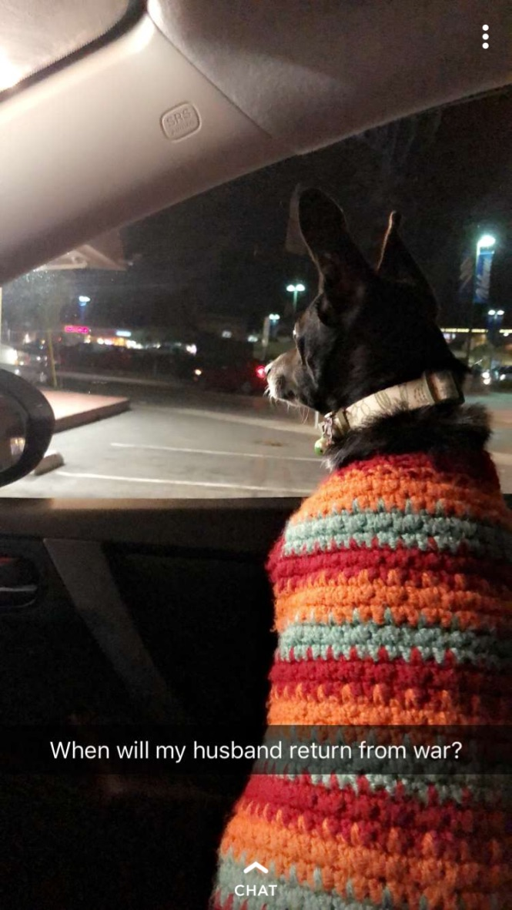
Concept

Slide 3
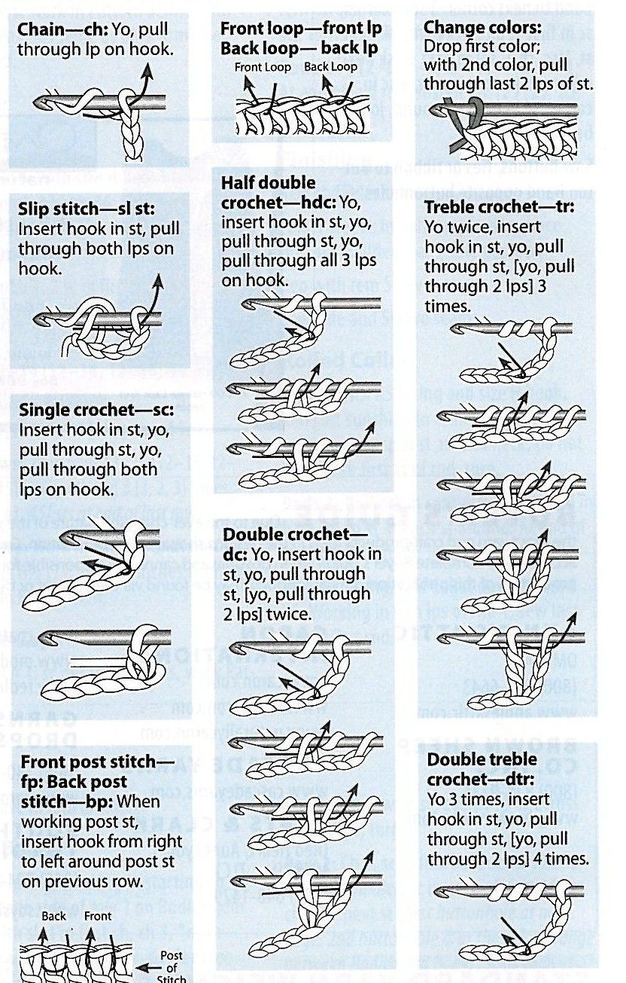
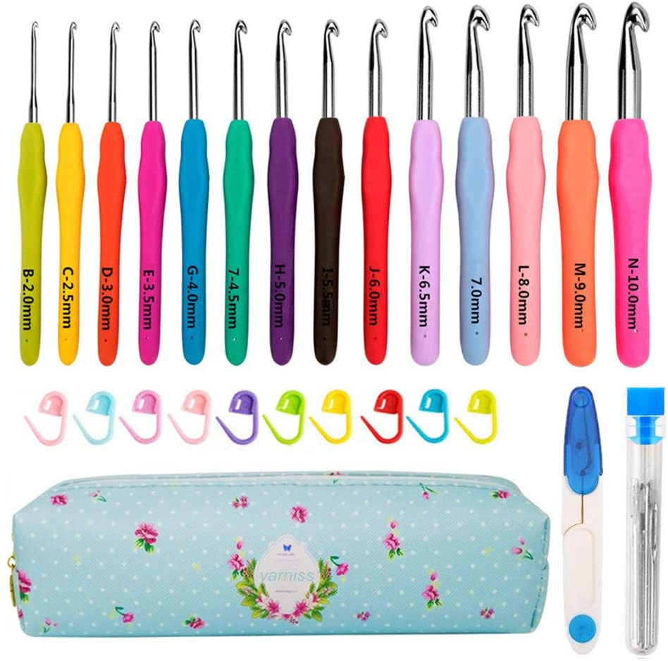
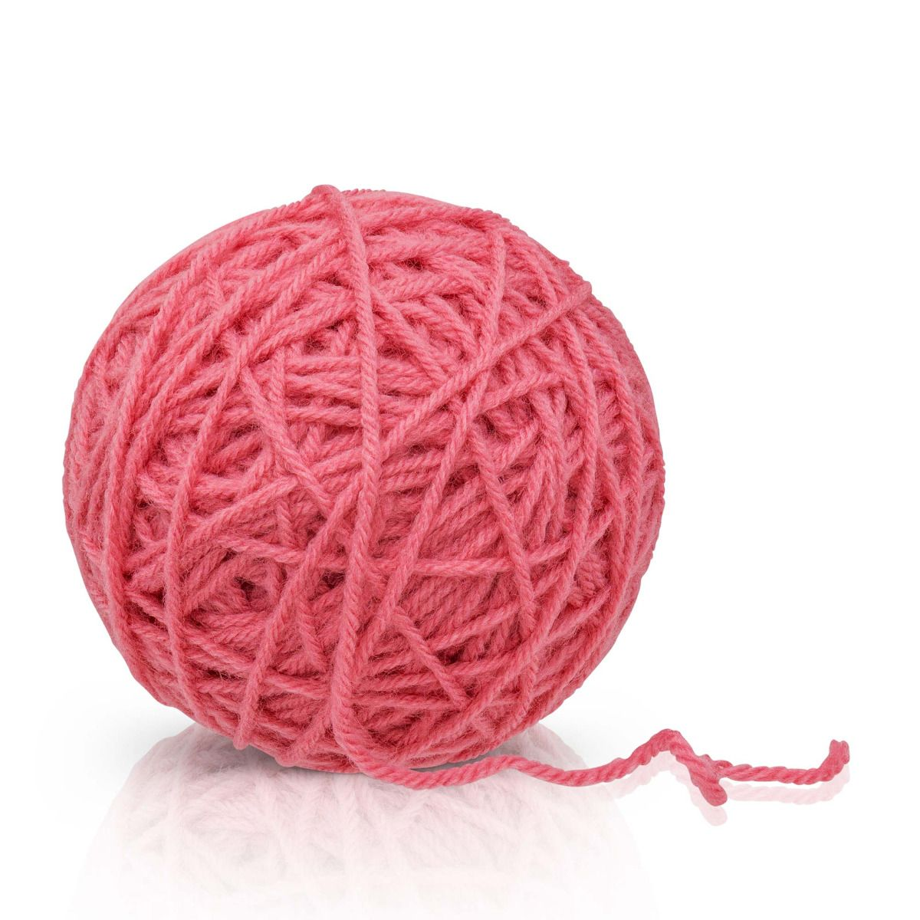
Basic Data Types in Crochet
Stitch Types
Yarn
Hooks

Slide 4
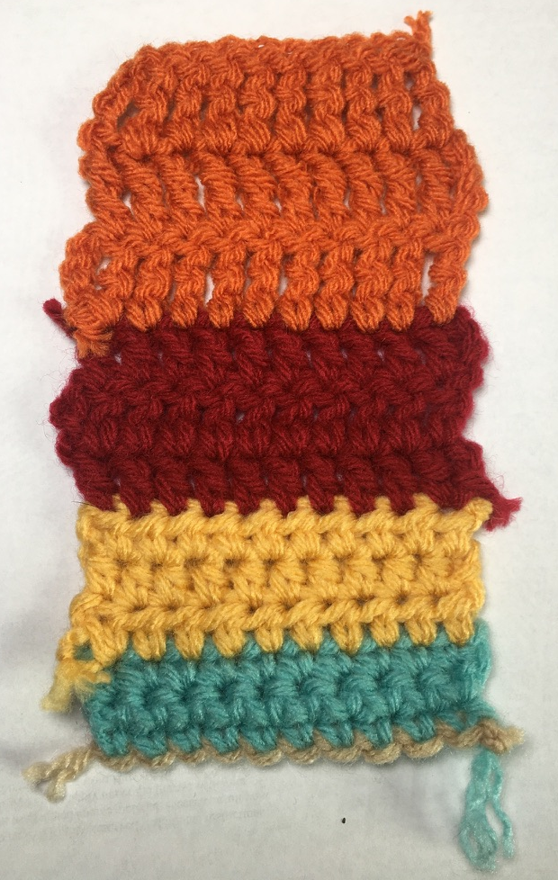
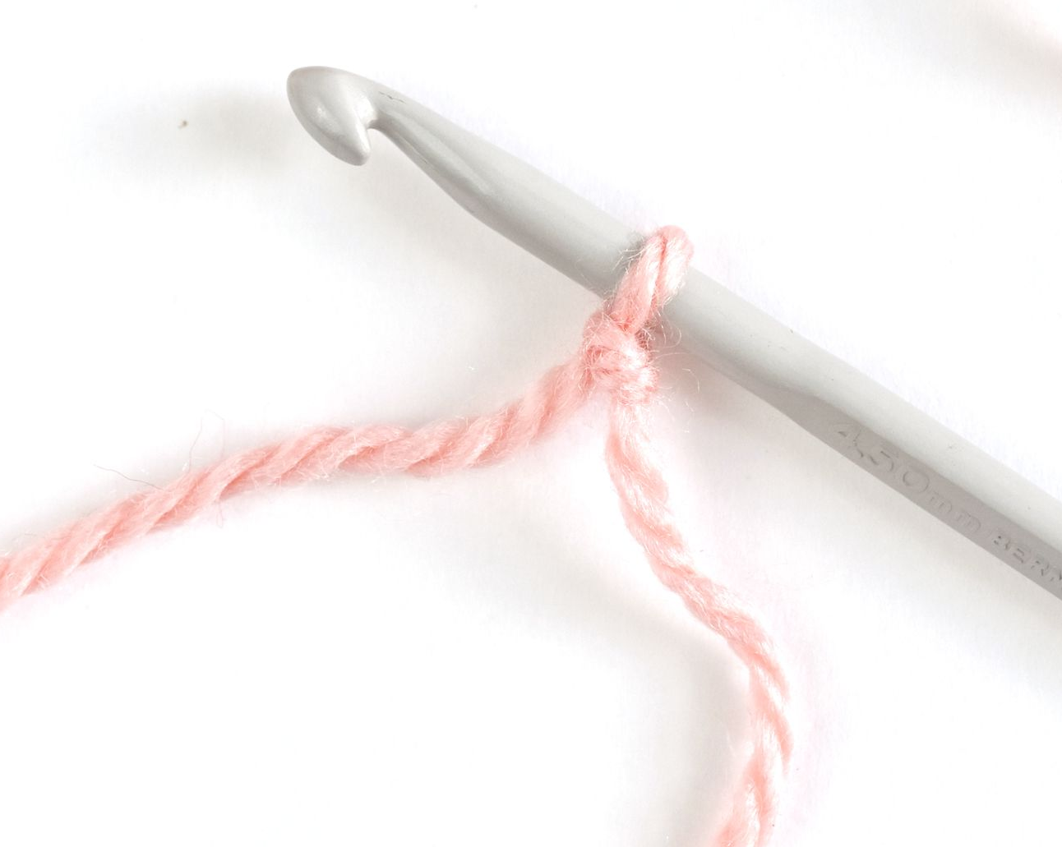
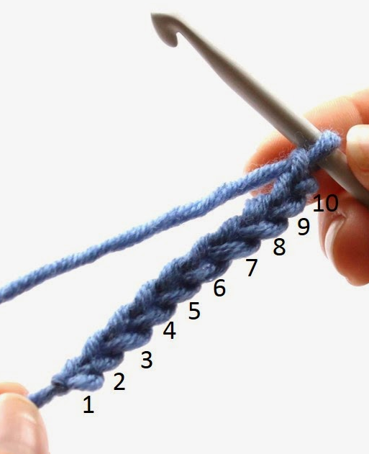
Crochet Data Structures
A Pattern is a sequence of Rows
A Stitch is comprised of Yarn, a Hook and a Stitch Type
= A
= pattern
pattern = row + (row1)*3 + (row2)*3…
= row
row = A*10
A Row is a sequence of stitches

Slide 5
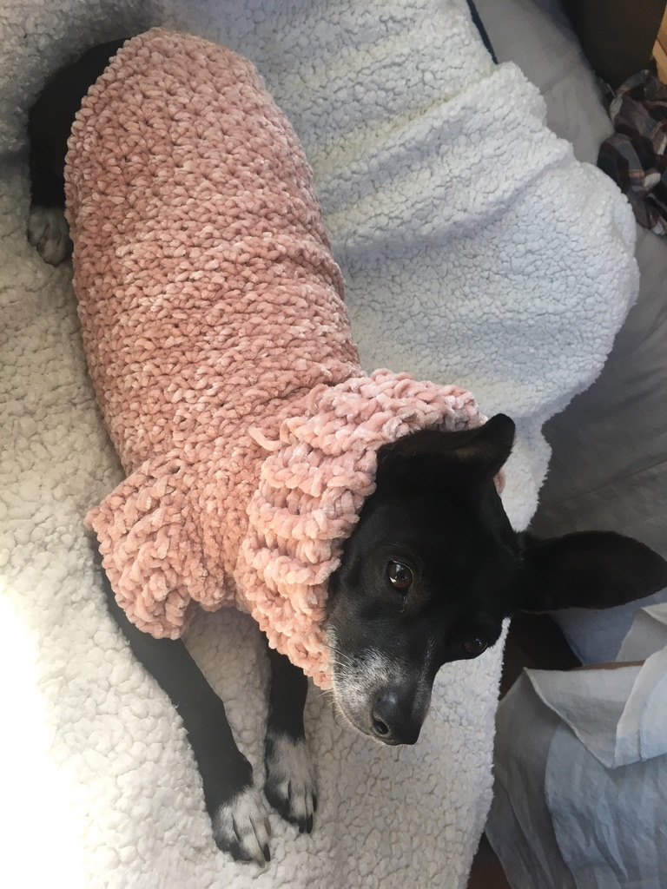
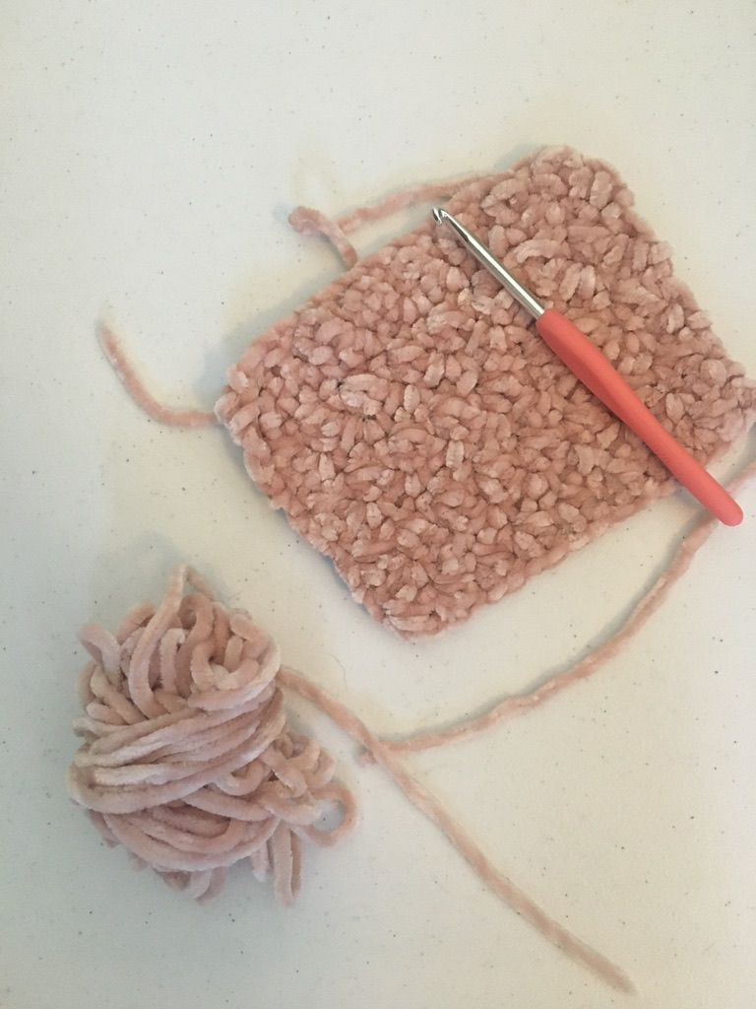
Gauge Square

Slide 6
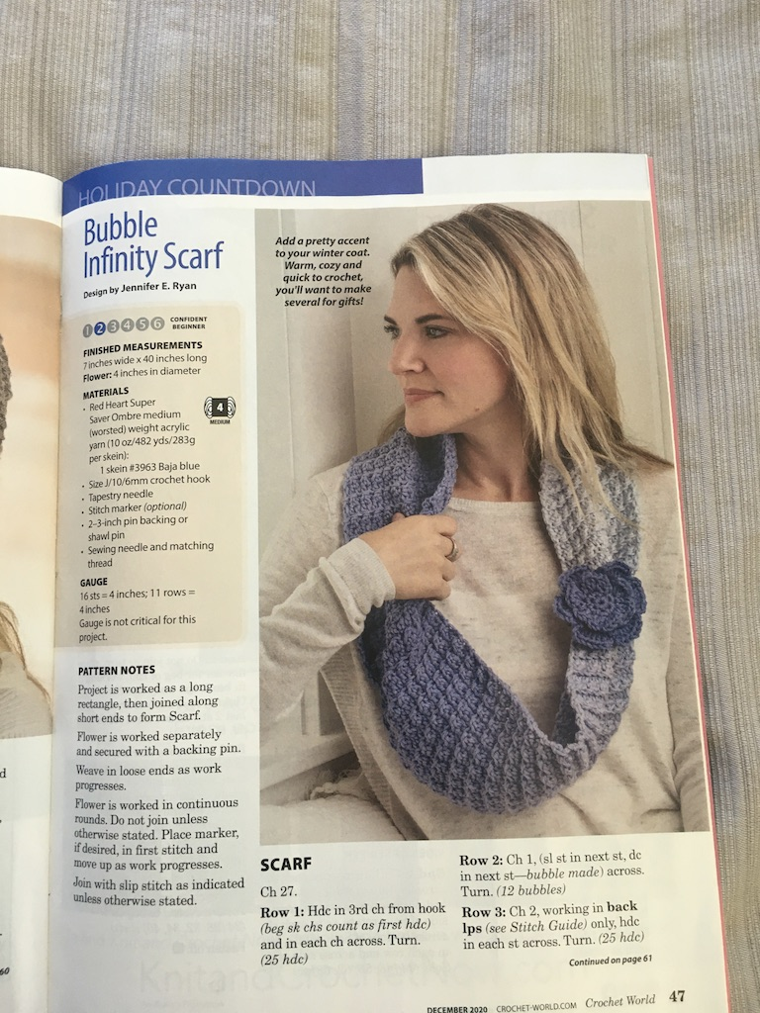
Simple Pattern Example:
Materials:
Yarn: Red Heart Super Saver Ombre – Baja Blue
Hook: 6 mm
Stitch Types: ch, hc, sl, dc
Row Patterns:
Row 1 = ch*25
Row 2 = hc*25
Row 3 = (sl + dc)*12 + sl
Repeat Row2 and Row 3 until desired length is achieved

Slide 8
Resources
https://marymaxim.cdn.speedyrails.net/media/catalog/product/cache/afad95d7734d2fa6d0a8ba78597182b7/5/5/554-rose-wrapped_1.jpg
https://images-na.ssl-images-amazon.com/images/I/61iFGjlQbML._AC_SX569_.jpg
https://i.pinimg.com/736x/65/65/0c/65650cfbb2b21c20ef8dcc4f6cc3bd77--crochet-instructions-crochet-tutorials.jpg
https://www.thesprucecrafts.com/thmb/OmDAGr6x8T5aaK_eoJ-ruvnphDY=/1867x1867/smart/filters:no_upscale()/SlipKnotCrochet1-5bbd0ebc4cedfd0026f809cd.jpg
http://1.bp.blogspot.com/-JDmyl-TyFiU/U9eWLICgZNI/AAAAAAAABz0/dAmNPRSBs90/s1600/Double+Crochet+1.jpg
Crochet World Magazine

